Slide 1

Durgapur Institute of Advanced Technology and Management
Project Title: REAL TIME EMOTION DETECTION WITH MANWATCHING
Under the supervision of
Prof. Kaustav Sanyal
Presented by:
Name University Roll
SRISTITA PAUL | 15500121020
ROSHNI CHAUBEY | 15500122087

Slide 2
CONTENTS
Introduction
Project Objectives
System Overview
Visual Representation
Example Usage
Tools and Technology
Sample Output
Future Improvements
Conclusion

Slide 3
Introduction
What is Emotion Detection?
Finding out how people feel by looking at their faces, listening to their voices, or checking other signals.
Uses smart technology to figure out emotions
Why is Real-Time Emotion Detection Important?
Gives instant feedback, making apps and devices more fun and useful.
Helps in mental health, customer service, and studying reactions.

Slide 4
Project Objectives
Identify and Categorize Emotions in Real-Time
Create a system that can recognize different emotions as they happen.
Use data from facial expressions to detect emotions like happiness, sadness, anger, etc.
Make the system very accurate in detecting emotions.

Slide 5
System Overview
Data Collection
Collect data from sources like webcams or video recordings.
Data Preprocessing
Clean and prepare the collected data.
Feature Extraction
Identify key features from the faces, such as eyes, mouth, and overall expression.

Slide 6
System Overview (cont.)
Model training:
Train machine learning models using labeled data.
Teach the system to recognize different emotions based on features.
Real-Time Detection:
Apply the trained models to live video feeds.
Detect and categorize emotions as they happen.
Map those emotions to the traits and micro-traits defined in the “Manwatching: A field guide to human behavior” by Desmond Morris.

Slide 7
Visual Representation
SURPRISE
INPUT FACE IMAGE
PREPROCESSING
FEATURE EXTRACTION
SMILE
SAD
Load Replacement Rules
ANGER
FEAR
DATASET FACE IMAGE
PREPROCESSING
FEATURE EXTRACTION
DISGUST
NETURAL

Slide 8
Example Usage
Cameras watch people's faces at an event.
Software quickly checks if they look happy, sad, or other emotions.
They can adjust things if needed, like making a presentation clearer.
After the event, they analyze the data to plan better for next time.

Slide 9
Tools and Technology
Libraries Used For Real-Time Detection:
Python
OpenCV (cv2):
Used for capturing video from the webcam.
Performs face detection using Haar cascades.
Keras (keras.models):
Loads the pre-trained model from a JSON file and weights from an H5 file.
Used to predict emotions from the processed images.

Slide 10
Tools and Technology (cont.)
Libraries Used For Real-Time Detection:
NumPy (numpy):
Handles numerical operations and image data manipulation.
Random (random):
CSV (csv):
Reads the emotion labels from a CSV file and organizes them into groups for random selection.

Slide 11
Tools and Technology (cont.)
Libraries Used For Data Processing:
os:
Accesses and interacts with the operating system, particularly for file path operations.
numpy (np):
Handles numerical operations and array manipulations efficiently.
pandas (pd):
Manages and processes data in DataFrame structures for easier handling of datasets.

Slide 12
Tools and Technology (cont.)
Libraries Used For Data Processing:
sklearn.preprocessing (LabelEncoder):
Encodes categorical labels into numeric form for machine learning models.
tensorflow.keras:
load_img, img_to_array: Loads and converts images to arrays.
to_categorical: Converts class vectors to binary class matrices.
Sequential, model_from_json: Builds and loads models.

Slide 13
Tools and Technology (cont.)
Libraries Used For Data Processing:
tensorflow.keras:
Conv2D, MaxPooling2D, Dropout, Flatten, Dense: Defines layers for the Convolutional Neural Network (CNN).
Adam: Optimizer used for compiling the model.
TensorBoard, EarlyStopping: Callbacks for monitoring and early stopping during training

Slide 14
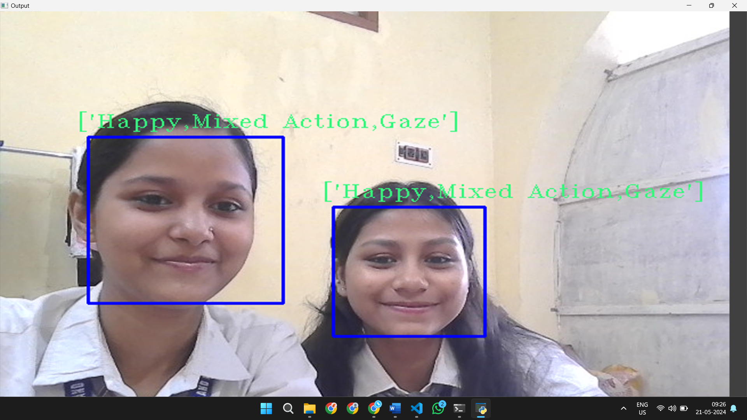
SAMPLE OUTPUT

Slide 15
Future Improvement
Collect diverse emotional expressions from various cultures for better accuracy.
Use advanced machine learning models for more precise emotion detection.
Integrate facial recognition with voice and body language etc.

Slide 16
Conclusion
Enhancing real-time emotion detection involves broadening data diversity, integrating multimodal inputs, and utilizing advanced algorithms. These improvements will increase accuracy and speed while ensuring ethical standards, paving the way for more reliable and inclusive emotion recognition systems.

Slide 17
THANK YOU

